Slide 1
Inferential Statistics
A Primer

Slide 2
A Riddle
What do the sands say to the waves when they meet?

Slide 3
The Answer
Long Time No See (Sea)

Slide 4
Basic Concepts

Slide 5
“Statistics is the science of learning from data, and of measuring, controlling and communicating uncertainty.”
- The American Statistical Association (ASA)

Slide 6
Two Branches of Statistics
Descriptive Statistics
Inferential Statistics
About counting
Count what we observe
We know the sample
The evidence, the sample data collected, the things measured
Contains noises
About guessing
Guess what we don’t know
We don’t know the population
“the truth, the whole truth, and nothing but the truth.”
Truth is unknowable.

Slide 7
Two Foundational Theorems
Law of Large Numbers (LLB)
Central Limit Theorem (CLT)
As sample size increases, sample mean gets closer to the population mean.
The distribution of sample mean is approximately a normal distribution.

Slide 8
Normal Distribution
The normal or Gaussian distribution is a continuous probability distribution characterized by a symmetric bell-shaped curve. A normal distribution is defined by its center (mean) and spread (standard deviation). The bulk of the observations generated from a normal distribution lie near the mean, which lies at the exact center of the distribution: as a rule of thumb, about 68% of the data lies within 1 standard deviation of the mean, 95% lies within 2 standard deviations and 99.7% lies within 3 standard deviations. The normal distribution is perhaps the most important distribution in all of statistics. It turns out that many real-world phenomena, like IQ test scores and human heights, roughly follow a normal distribution, so it is often used to model random variables. Many common statistical tests assume distributions are normal.

Slide 9
Hypothesis Testing

Slide 10
Two Types of Hypothesis
To hypothesis is to make an educated guess
Null Hypothesis (H0)
Alternate Hypothesis (H1)
Currently accepted theory about the truth
H0: Vioxx is safe
May 1999: FDA approved Vioxx.
Vioxx is a drug for treating arthritis and relieving pain
Challenge to the prevailing theory the truth
H1: Vioxx is not safe
Sept. 2004: Merck withdrew Vioxx from the market.
Patients taking Vioxx in a study were twice as likely to suffer a heart attack or stroke as those on placebo.
https://usatoday30.usatoday.com/news/health/2004-10-12-vioxx-cover_x.htm

Slide 11
Three Types of Hypothesis Testing
Type | Null Hypothesis | Alternative Hypothesis
Right-tailed | H₀ : μ = 3 | H_{A} : μ > 3
Left-tailed | H₀ : μ = 3 | H_{A} : μ < 3
Two-tailed | H₀ : μ = 3 | H_{A} : μ ≠ 3

Slide 12
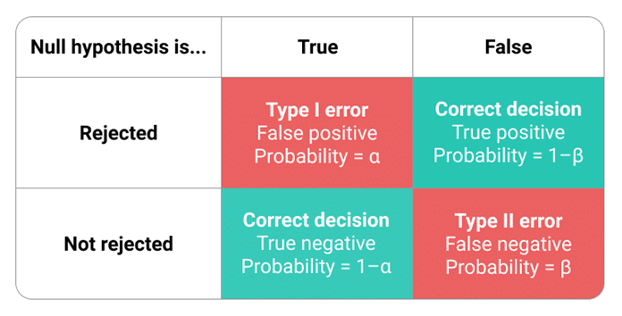
Type I and II Error
A Type I error means rejecting the null hypothesis when it’s actually true.
A Type II error means not rejecting the null hypothesis when it’s actually false
The risk of committing a type I error is the significance level (alpha or α,aka p-value)
For non-critical study (social) p = 0.05
For critical study (healthcare) p = 0.01
P-value = 0.05 means: There is a 5% chance that the null hypothesis is true given the data/evidence collected. So By rejecting the null hypothesis, we have a 5% chance of making the wrong decision.

Slide 13
Decision Making in Hypothesis Testing
It is either likely or unlikely that we would observe the evidence we did given our initial assumption that the null hypothesis is true.
If it is likely, we do not reject the null hypothesis.
If it is unlikely, then we reject the null hypothesis in favor of the alternative hypothesis.
Making decision is determining the "likelihood" or "unlikelihood“.

Slide 14
One Sample Z Test – The Grandpa of HT
A principal claims that his students are above average intelligence. A random sample of thirty students from his school has a mean IQ score of 112.5.
Is there sufficient evidence to support the principal’s claim?
The average IQ of general population is 100 with a standard deviation of 15.
H0: The students are as intelligent as the general population (school IQ mean = 100)
H1: The students are smarter than the general population (school IQ mean > 100)

Slide 15
One-sample t-Test Example: Gum Thickness
A manufacturer claims that the thickness of the spearmint gum it produces is 7.5 one-hundredths of an inch. A quality control specialist regularly checks this claim. On one production run, he took a random sample of n = 10 pieces of gum and measured their thickness.
Data:
7.65 7.60 7.65 7.70 7.55
7.55 7.40 7.40 7.50 7.50
Hypotheses:
H0 : μ = 7.5
HA : μ ≠ 7.5

Slide 16
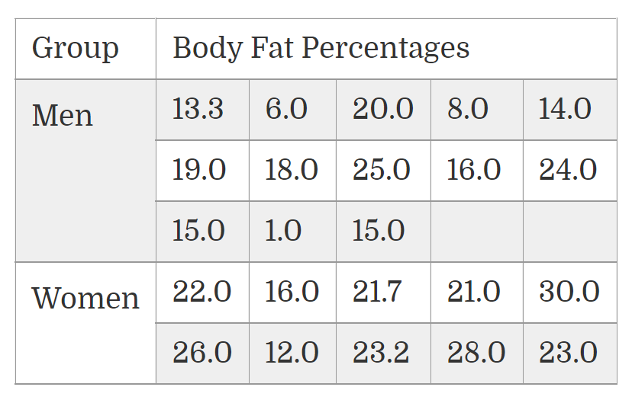
Two-sample t-Test Example: Body Fat
One way to measure a person’s fitness is to measure their body fat percentage.
Average body fat percentages vary by age, but according to some guidelines, the normal range for men is 15-20% body fat, and the normal range for women is 20-25% body fat.
Our sample data is from a group of men and women who did workouts at a gym three times a week for a year. Then, their trainer measured the body fat.
Ho: μ1=μ2
Ha: μ1≠μ2

Slide 17
References
https://online.stat.psu.edu/statprogram/
https://www.statisticshowto.com/probability-and-statistics/hypothesis-testing/

